Slide 1
Management of wound heamatoma after neck surgery
A junior doctor’s guide

Slide 2
Background
Occurs in approximately 1% of patients undergoing thyroid or parathyroid surgery
May result in laryngeal and sub-glottic oedema and airway obstruction
If respiratory distress, need anaesthetist and surgeon

Slide 3
Haematoma may enlarge rapidly within a few minutes
Potentially life-threatening and patient feels “about to die”
No local or general anaesthetic required to explore wound if airway compromise
No sharp implements needed

Slide 4
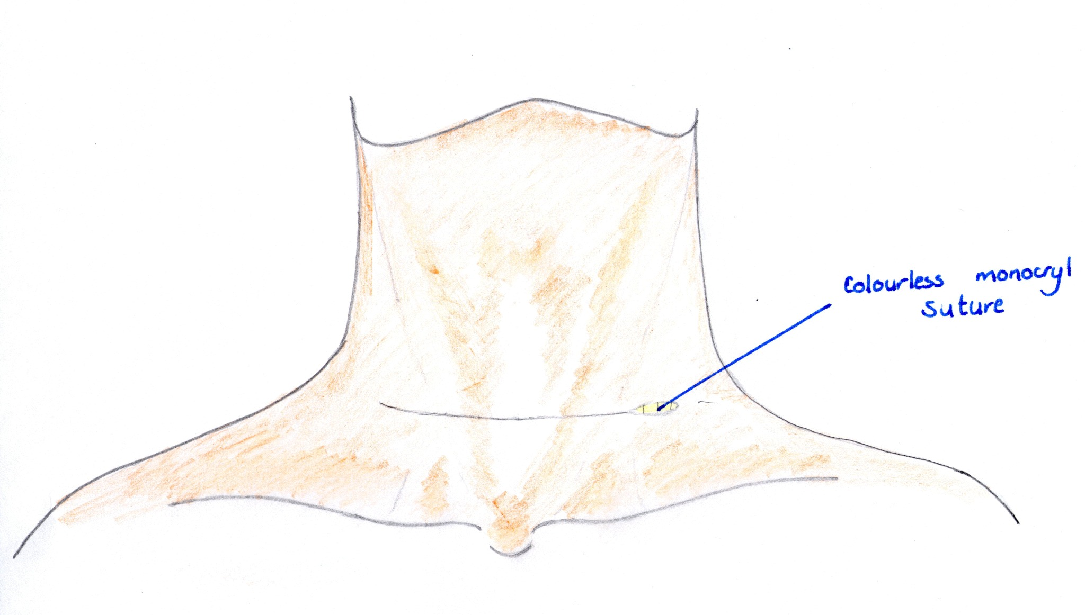
1. Open one end of the wound with finger pressure, grip suture crossing wound and pull to remove
Colourless Monocryl Suture

Slide 5
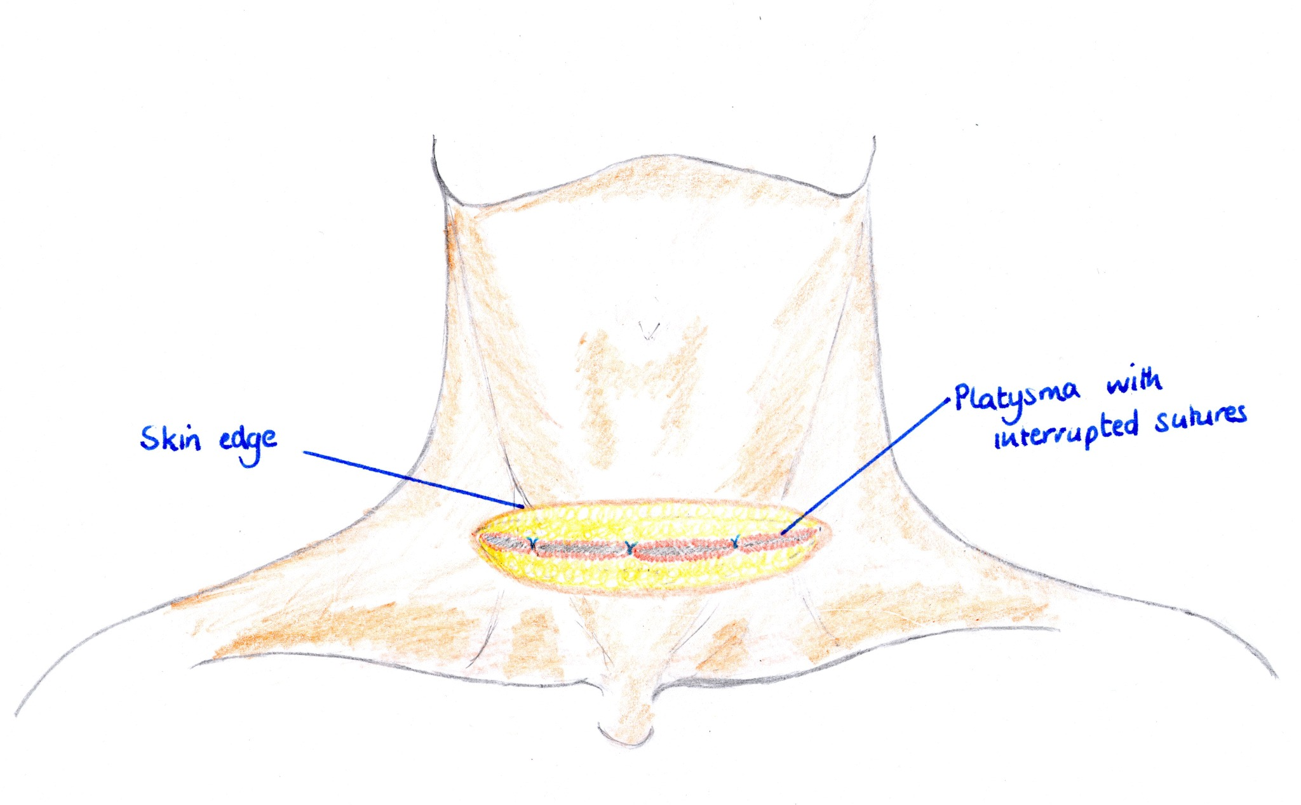
2. Pass a finger behind interrupted sutures in platysma and pull to disrupt
Platysma with interrupted sutures
Skin Edge

Slide 6
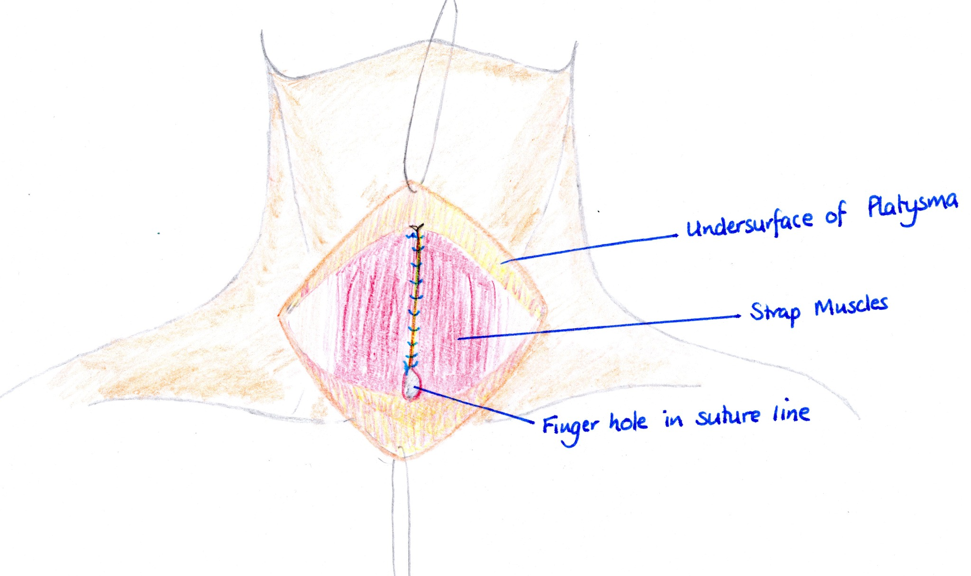
3. Pass finger into space at inferior end of suture line between strap muscles down onto anterior surface of trachea and pull sharply upwards to disrupt, cutting the suture if necessary
Undersurface of platysma
Strap Muscles
Finger hole in sutureline

